Slide 1

UNIVERSITY OF MASSACHUSETTS
Dept. of Electrical & Computer Engineering
Digital Computer Arithmetic
ECE 666
Part 2
Unconventional Number Systems
Israel Koren
Spring 2004

Slide 2
Unconventional Fixed-Radix Number Systems
Number system commonly used in arithmetic units - binary system with two's complement representation of negative numbers
Other number systems have proven to be useful for certain applications -
Negative radix number system
Signed-digit number system
Sign-logarithm number system
Residue number system

Slide 3
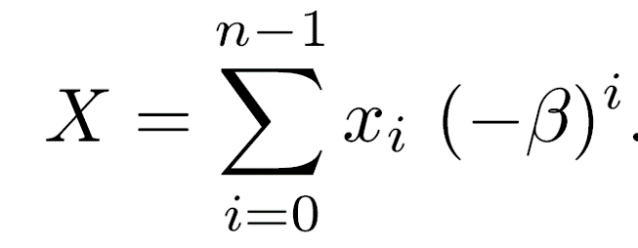
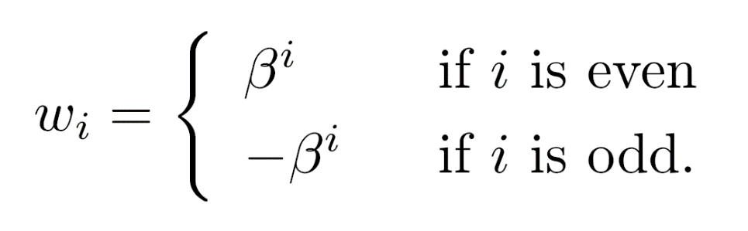
Negative-Radix Number Systems
The radix r of a fixed-radix system - usually a positive integer
r can be negative - r=-β (β - a positive integer)
Digit set - xi = 0,1,...,β-1
Value of n-tuple (xn-1,xn-2,...,x0) -
The weight wi is -

Slide 4
Example - Negative-Decimal System
Negative-radix number system with β=10 - nega-decimal system
Three-digit nega-decimal numbers -
  192-10 =100-90+2=12 ; 012-10=-10+2=-8
  Largest positive value - 909-10=90910
  Smallest value - 090-10=-9010
  Asymmetric range - -90 ≤ X ≤ 909
  Approximately 10 times more positives than negatives
This is always true for odd values of n - opposite for even n
Example - the range for n=4 is -9090 ≤ X ≤ 909

Slide 5
Negative-Radix Number Systems - Properties
No need for a separate sign digit
No need for a special method to represent negative numbers
Sign of number is determined by the first nonzero digit
No distinction between positive and negative number representations - arithmetic operations are indifferent to the sign of the numbers
Algorithms for the basic arithmetic operations in the negative-radix number system are slightly more complex then their counterparts for the conventional number systems

Slide 6
Example - Negative-Binary System
Negative-radix numbers of length n=4, β=2 - nega-binary system
Range - -1010=1010-2 ≤ X ≤ 0101-2=+510
When adding nega-binary numbers - carry bits can be either positive or negative
Example: -8 +4 -2 +1 0 0 1 0 -2 0 0 1 1 -1 1 1 0 1 -3
Nega-binary - proposed for signal processing applications
Algorithms exist for all arithmetic operations
Did not gain popularity: Main reason - not better than the two's complement system

Slide 7
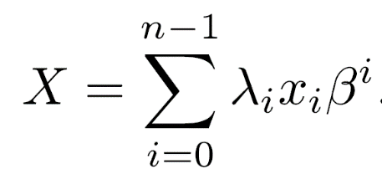
A General Class of Fixed-Radix Number Systems
The negative-radix, and many other fixed-radix number systems are members of a broad class of non-redundant number systems
An n-digit number system - characterized by a positive radix β, digit set 0,1,...,β-1, a vector Λ of length n - Λ=(λn-1,λn-2,...,λ0) ; λi=-1,1
System identified by triplet < n , β , Λ >
The value X of an n-tuple (xn-1, xn-2,...,x0) is
The multiplying factor Λ allows a different selection between β and -β for every digit position i
i
i

Slide 8
Special Cases of General Class
n
For any given radix - 2 different number systems corresponding to the different values of Λ
Positive-radix number system - λi=+1 for every i
Negative-radix number system - λi=(-1) for every i
Radix-complement number system with xn-1 as a “true” sign digit (xn-1=0,1) - Λ = (-1,1,1,...,1)
i

Slide 9
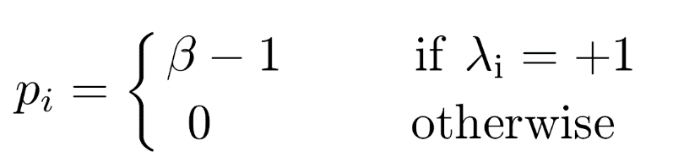
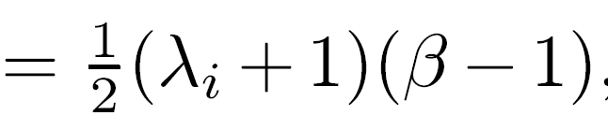
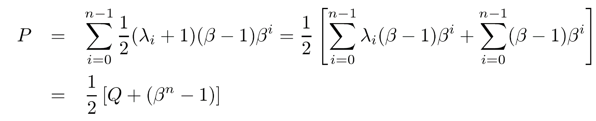
General Class <n,β,Λ> - Largest Representable Integer
P=(pn-1,pn-2,...,p0)
Q - value of n-tuple (β-1,β-1,...,β-1)

Slide 10
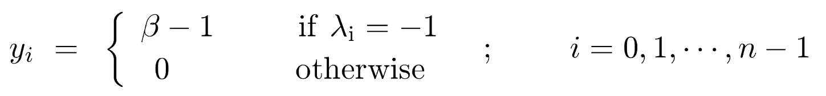
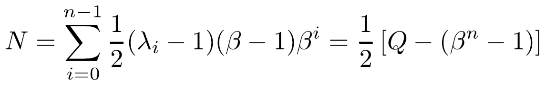
General Class <n,β,Λ> - Smallest Representable Integer
N=(yn-1,yn-2,...,y0)
Range N ≤ X ≤ P is asymmetric (in general)
Number of integers in range - P-N+1 = β
Measure of asymmetry - difference between the absolute values of the largest and smallest numbers - P-|N| = P+N = Q
n

Slide 11
Range of System - Examples
Negative-radix system with Λ=(...,-1,+1,-1,+1) - asymmetric range
For an even n - β times more negative numbers than positive
To have more positive numbers - Λ=(...,+1,-1,+1,-1)
Two of the binary systems are nearly symmetric
Two's complement - < n,β=2,Λ=(-1,1,1,...,1) >
  P+N=Q=-ulp
< n,β=2,Λ=(+1,-1,-1,...,-1) >
  P+N=Q=+ulp

Slide 12
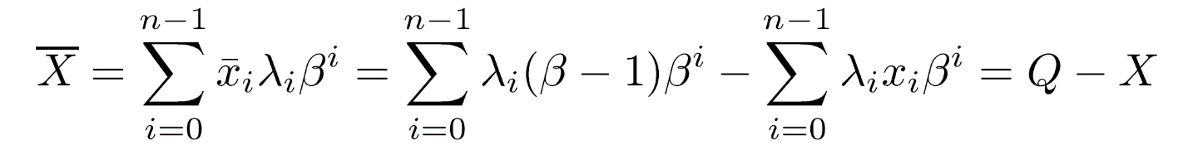
Additive Inverse and Subtraction in <n,β,Λ>
Complement of a digit xi - xi = (β-1) - xi
Complement X of a number X -
-X = X - Q = X + (-Q)
Additive inverse of X - adding the additive inverse of Q to the complement X
Subtraction - X - Y = X + Y + (-Q)
  Two add operations with carry propagation - time consuming
Alternative - X - Y = X + Y
  Two digit-complement operations, and only one addition with carry-propagation
-
-
-
-
-
-
___
-

Slide 13
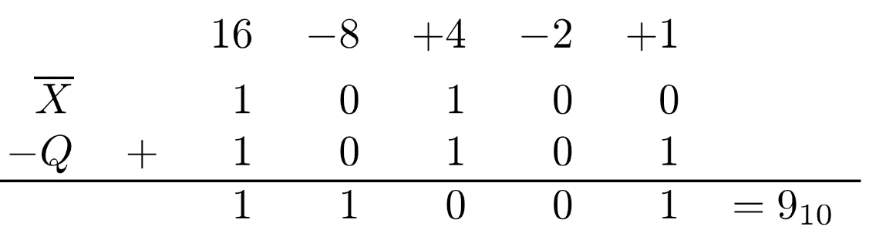
Example
_
Two's complement system - Q=-ulp and -X=X+ulp
Nega-binary system
  Q = (...,1,1,1,1)-2 = -(...,0,1,0,1)-2
  -Q = (...,0,1,0,1)-2
Example - additive inverse of (01011)-2=(-9)10
Addition - following rules of nega-binary addition
Result can be verified by adding the original number to its additive inverse (nega-binary addition)
(01011)-2 + (11001)-2 = (00000)-2

Slide 14
Signed-Digit Number Systems
So far - digit set {0,...,r-1}
In the signed-digit (SD) number system, digit set is {r-1,r-2,…,1,0,1,...,r-1} ( i = -i)
No separate sign digit
Example:
  r=10, n=2 ; digits - {9,8,...,1,0,1,...,8,9}
  Range - 99 ≤ X ≤ 99 - 199 numbers
  2 digits, 19 possibilities each - 361 representations - redundancy
  01=19=1 ; 02=18=-2
  Representation of 0 (or 10) is unique
  Out of 361 representations, 361-199=162 are redundant - 81% redundancy
  Each number in range has at most two representations
__
__
-
-
-
-
-
-
-
-
-
-

Slide 15
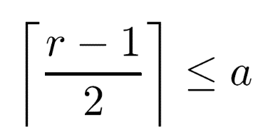
Reducing Redundancy in Signed-Digit Number Systems
Redundancy can be beneficial - but more bits needed
Reducing redundancy - digit set restricted to
  ⎡ x ⎤ - smallest integer larger than or equal to x
To represent a number in a radix r system - at least r different digits are needed
a ≤ xi ≤ a - 2a+1 digits
2a+1 ≥ r and
-

Slide 16
Example - SD Number System
r=10 - range of a is 5 ≤ a ≤ 9
If a=6, n=2 - 133 numbers in range 66 ≤ X ≤ 66
13 values for each digit - total of 13 =169 representations - 27% redundancy
1 has only one representation - 01 - 19 is not valid
4 has two representations - 04 and 16
-
-
2
-
-

Slide 17
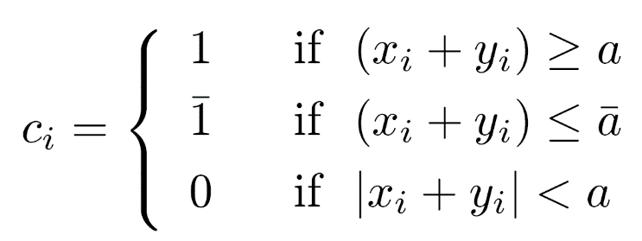
Eliminating Carry Propagation Chains
Calculating (xn-1,...,x0) ± (yn-1,...,y0)=(sn-1,...,s0)
Breaking the carry chains - an algorithm in which sum digit si depends only on the four operand digits xi, yi, xi-1, yi-1
Addition time independent of length of operands
An algorithm that achieves this independence:
Step 1: Compute interim sum ui and carry digit ci
ui = xi + yi - r ci where
Step 2: Calculate the final sum si = ui + ci-1

Slide 18
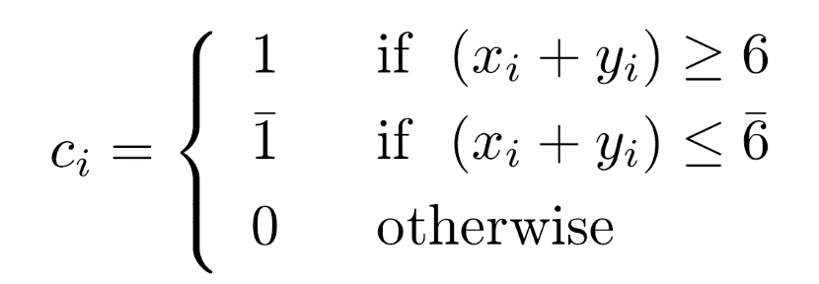
Example - r=10, a=6
-
xi=6,...,0,1,...,6
Step 1 - ui =( xi+yi )-10 ci
Example - 3645+1456
  3645 + 1456 5101
In conventional decimal number system - carry propagates from least to most significant digit
Here - no carry propagation chain
Carry bits shifted to left to simplify execution of second step
3 6 4 5 x
+ 1 4 5 6 y
0 1 1 1 c
4 0 1 1 u
5 1 0 1 s
-

Slide 19
Converting Representations
This addition algorithm can be used for converting a decimal number to SD form by considering each digit as the sum xi+yi above
Example - converting decimal 6849 to SD xi+yi 6 8 4 9 c 1 1 0 1 u 4 2 4 1 s 1 3 2 5 1
Converting SD to decimal - subtracting digits with negative weight from digits with positive weight
Example - converting 13251 to decimal 10050 -03201 6849
-
-
-
-
-
-
-
-
-

Slide 20
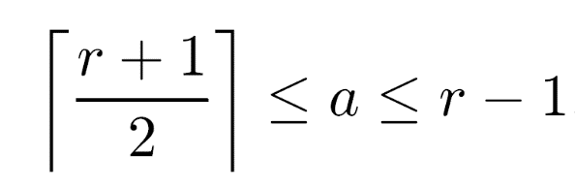
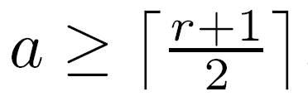
Proof of the Two-Step Algorithm
To guarantee no new carry - |si| ≤ a
Since |ci-1|≤1, |ui| must be ≤ a-1 for all xi,yi
Example - largest xi+yi is 2a ⇒ ci=1, ui=2a-r since a ≤ r-1, ui=2a-r ≤ a-1
Example - smallest xi+yi for which ci=1 is a ⇒ ui=a-r<0 or |ui|=r-a; to get |ui| ≤ a-1, 2a ≥ r+1
Selected digit set must satisfy
Exercise - show that for all values of xi+yi, |ui| ≤ a-1 if
Example - for SD decimal numbers, a ≥ 6 guarantees no new carries in previous algorithm

Slide 21
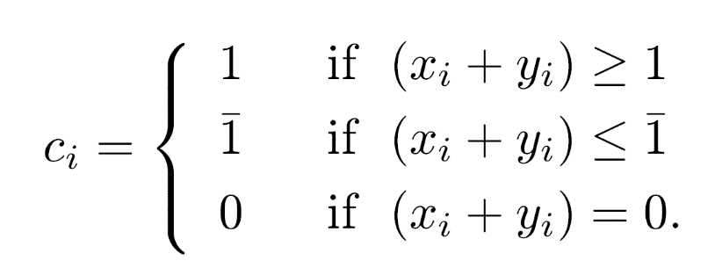
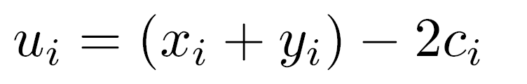
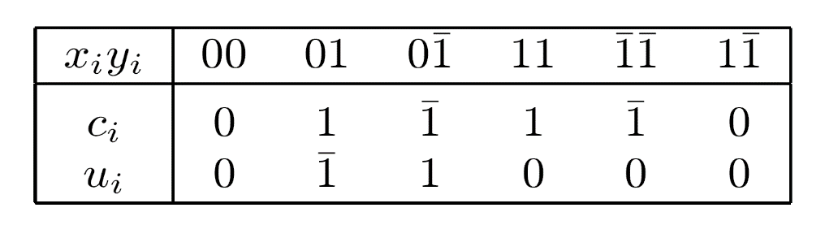
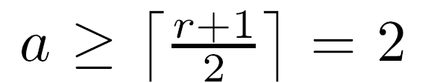
Addition of Binary SD Numbers
-
Only one possible digit set - {1,0,1} - a=1
Interim sum and carry in addition algorithm -
Summary of rules -
Addition is commutative - 10,10,11 not included
In the binary case - cannot be satisfied
No guarantee that a new carry will not be generated in the second step of the algorithm
-
-
-
-
-
-
-
-
-

Slide 22
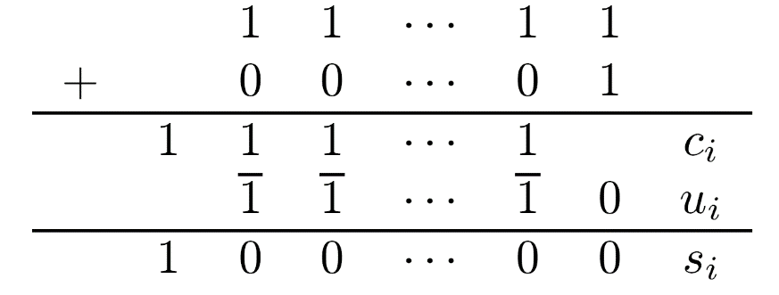
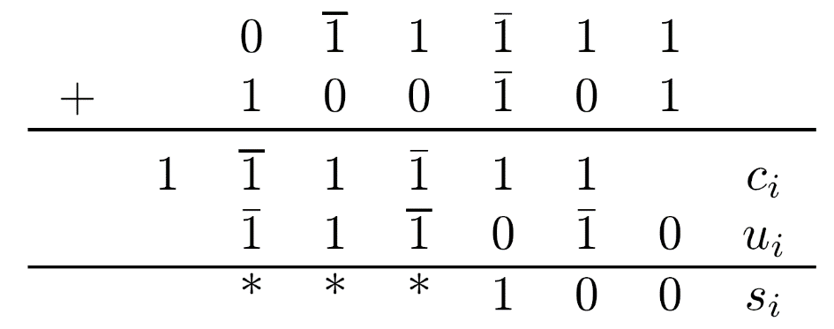
Addition - Carry Generation
-
If operands do not have 1 - new carries not generated
Example -
  In conventional representation - a carry propagates from least to most significant position
  Here - no carry propagation chain exists
If operands have 1 - new carries may be generated
Example -
  If xi-1yi-1 = 01 - ci-1 = 1 and if xiyi = 01 - ui = 1 si = ui+ci-1 = 1+1 - a new carry is generated
  Stars indicate positions where new carries are generated and must be allowed to propagate
-
-

Slide 23
Addition - Avoiding Carry Generation
-
ci-1=ui=1 when xiyi = 01 and xi-1yi-1 = 11 or 01
Selecting ci=0 - ui = 1
However, for xi-1yi-1=11 ⇒ ci-1=1 and we must still select ci=1, ui=1
Similarly, when xiyi=01 and xi-1yi-1= 11 or 01, instead of ui=1 ⇒ select ci=0 & ui=1
ui and ci can be determined by examining the two bits to the right xi-1yi-1
ui and ci can still be calculated in parallel for all bit positions
-
-
-
-
-
-
-
-
-
-
-
-
-
-
-
-

Slide 24
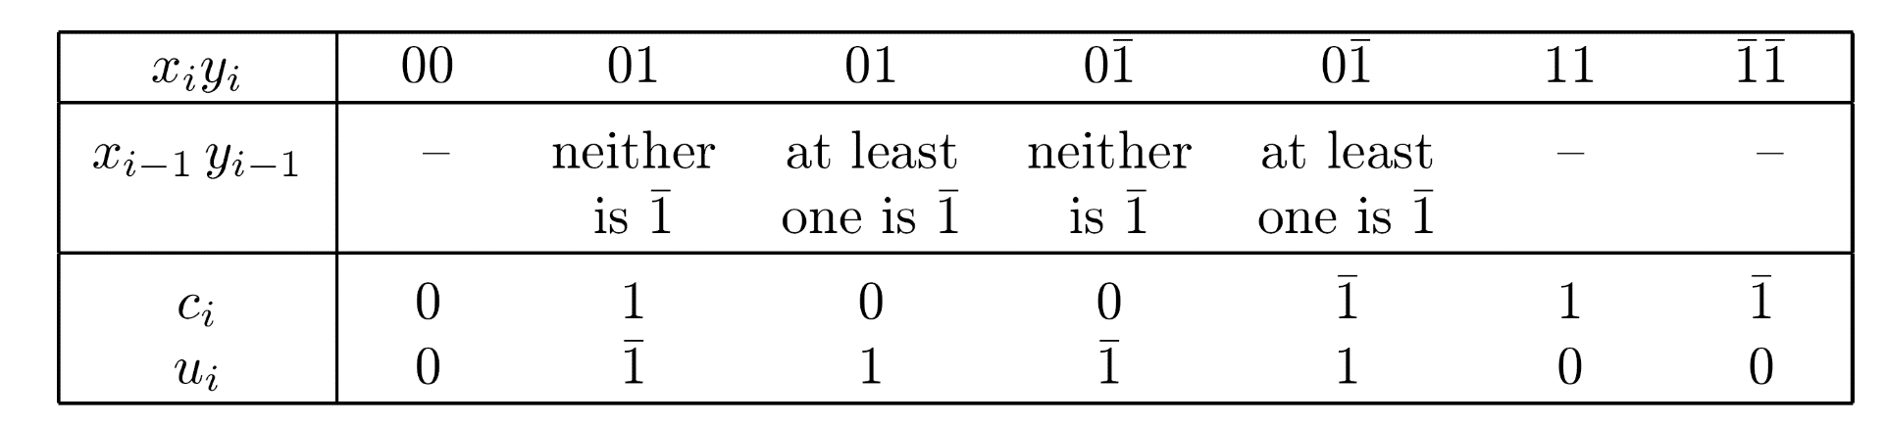
Addition of Binary SD Numbers - Modified Rules
Example - 1 1 0 1 1 7 0 1 1 0 0 -4 0 1 0 0 1 c 1 0 1 1 1 u 0 0 1 0 1 3
Direct summation of the two operands results in 00111, equivalent to 00101, all representing 310
-
-
-
-
-
-
-
-

Slide 25
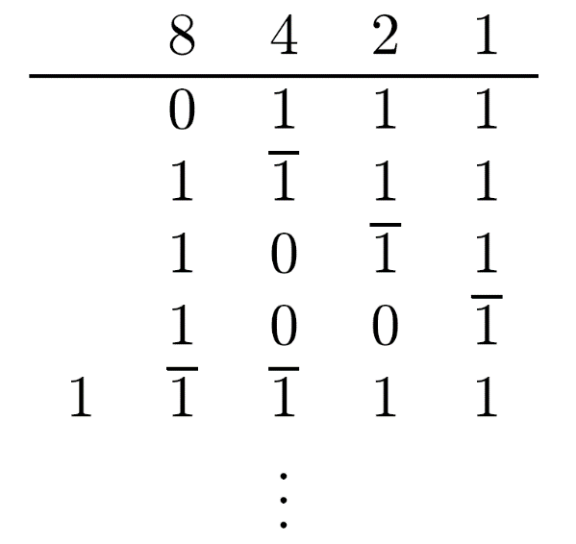
Minimal Representations of Binary SD Numbers
Representation with a minimal number of nonzero digits
Important for fast multiplication and division algorithms
Nonzero digits - add/subtract operations, zero digits - shift-only operations
Example - Representations of X=7:
1001 is the minimal representation
The canonical recoding algorithm generates minimal SD representations of given binary numbers
-

Slide 26
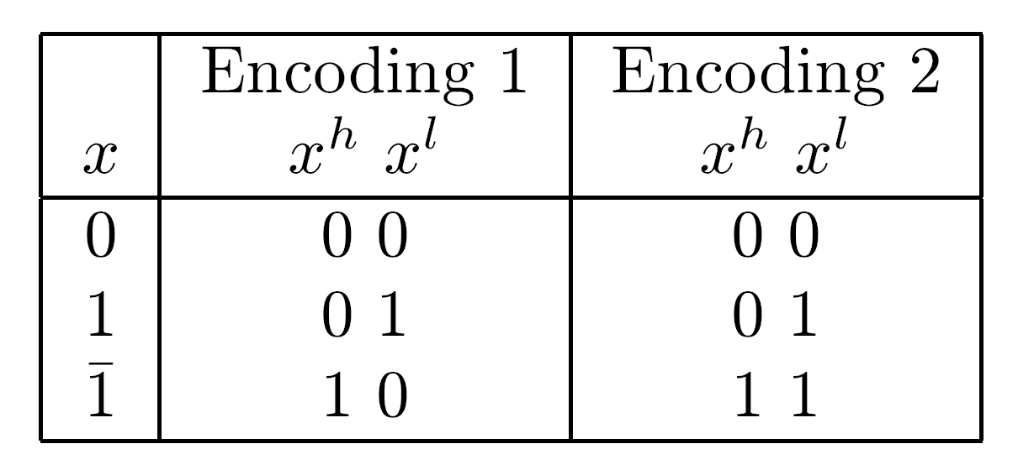
Encoding of SD Binary Numbers
4x3x2=24 ways to encode 3 values of a binary signed bit x using 2 bits, x and x (high and low)
Only nine are distinct encodings under permutation and logical negation - two have been used in practice
Encoding #2 - a two's complement representation of the signed digit x
Encoding #1 is sometimes preferable
  Satisfies x = x - x - 11 has a valid value of 0
  Simplifies conversion from SD to two's complement - subtracting xn-1, xn-2,...,x0 from xn-1,xn-2,...,x0 using two's complement arithmetic
  This requires a complete binary adder
  A simpler conversion algorithm exists
h
l
l
h
h
h
h
l
l
l

Slide 27
Conversion Algorithm - Simpler Circuit
  Binary signed digits examined one at a time, right to left
  All occurrences of 1 are removed and the negative sign is forwarded to the most significant bit, the only bit with a negative weight in the two's complement representation
  The rightmost 1 is replaced by 1 and the negative sign is forwarded to the left, replacing 0's by 1's until a 1 is reached, which ``consumes” the negative sign and is replaced by 0
  If a 1 is not reached - the 0 in the most significant position is turned into a 1, becoming the negative sign bit of the two's complement representation
  If a second 1 is encountered before a 1 is, it is replaced by a 0 and the forwarding of the negative sign continues
  The negative sign is forwarded with the aid of a “borrow” bit which equals 1 as long as a 1 is being forwarded, and equals 0 otherwise
-
-
-
-

Slide 28
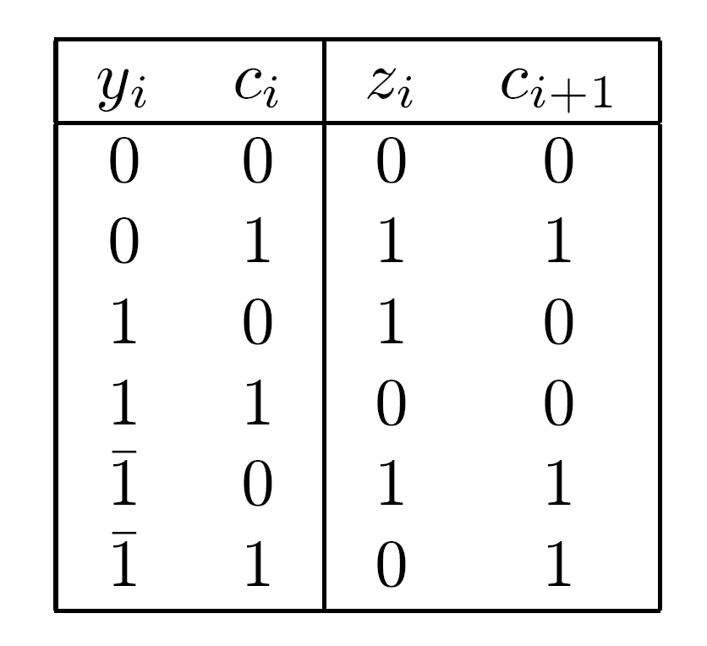
Conversion Algorithm Rules
yi - i-th digit of the SD number
zi - i-th bit of the two's complement representation
ci - previous borrow
ci+1 - next borrow
For the least significant digit we assume c0=0
yi - ci = zi - 2ci+1

Slide 29
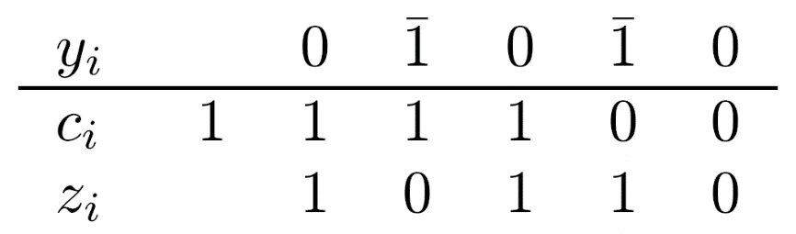
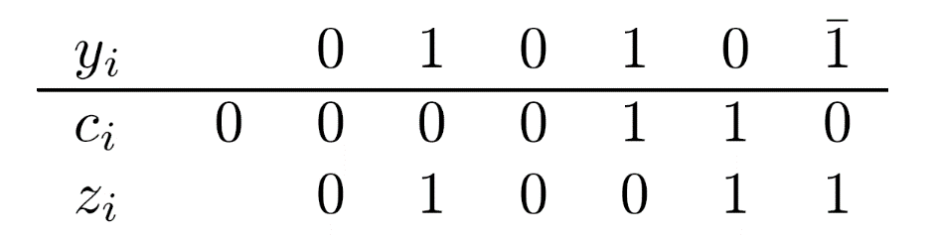
Conversion Algorithm - Cont.
Example - -1010 - converting SD to two's complement
Range of representable numbers in SD method - almost double that of the two's complement method
n-digit SD number must be converted to an (n+1)-bit two's complement representation
Without the extra bit position - the number 19 would be converted to -13

